Slide 1

Hospital Stay Prediction

Slide 2

Problem Statement
Recent Covid-19 Pandemic has raised alarms over one of the most overlooked area to focus: Healthcare Management. While healthcare management has various use cases for using data science, patient length of stay is one critical parameter to observe and predict if one wants to improve the efficiency of the healthcare management in a hospital.
Idea: Our aim is to train different models that can predict the stay of a patient in the hospital based on the initial conditions.
This helps hospitals to identify patients of high length of stay risk at the time of admission and can help in optimizing the treatment plan for patients who are likely to stay longer in the hospital and lower the chance of staff or visitor infection.

Slide 3

Data Preprocessing, Data visualization, Feature Extraction
Imputing missing values with mode
Removing unwanted columns
Encoding categorical features to numerical.
Oversampling as data is imbalanced
Splitting the dataset

Slide 4
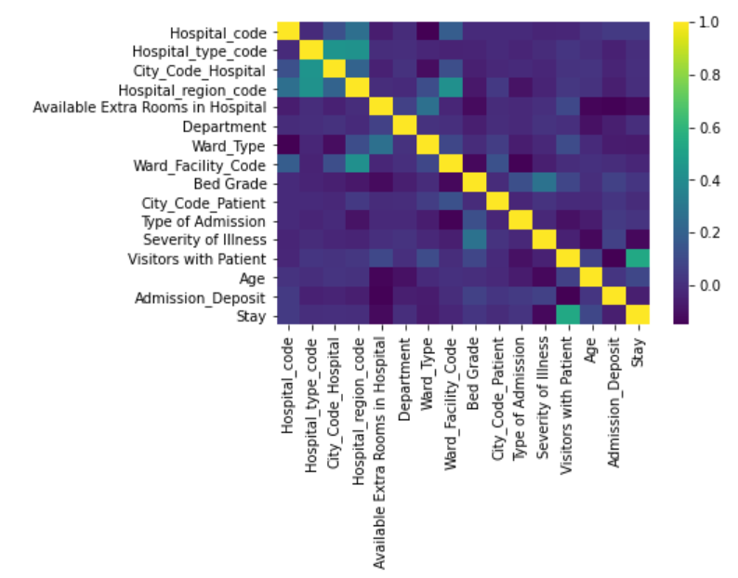
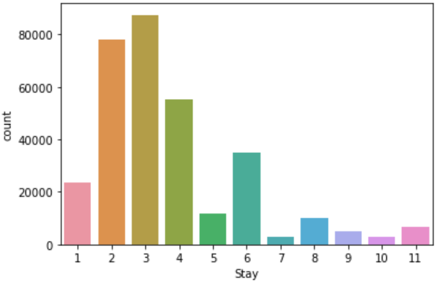
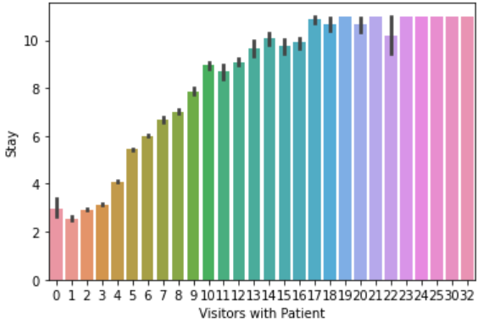
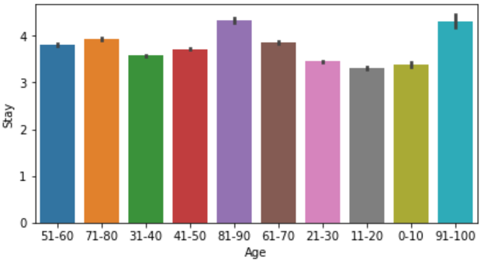

Slide 5

Decision Tree Classifier
A decision tree is a flowchart-like tree structure where an internal node represents feature(or attribute), the branch represents a decision rule, and each leaf node represents the outcome.
The topmost node in a decision tree is known as the root node.
Root node decides the split of date
Leaf node determines the class

Slide 6

Random Forest
Random Forest is a classifier that contains a number of decision trees on various subsets of the given dataset and takes the average to improve the predictive accuracy of that dataset.
The greater number of trees in the forest leads to higher accuracy and prevents the problem of overfitting.
Why Random Forest?
Random forest improves on bagging because it decorrelates the trees with the introduction of splitting on a random subset of features. This means that at each split of the tree, the model considers only a small subset of features rather than all of the features of the model.
Follows Bagging Technique

Slide 7

CatBoost Classifier
Performs Sequential learning
After each Iteration, Second model will correct the mistakes of the previous one
No need to hyper tune the hyper parameters
Lower chances of OverFitting

Slide 8

Smote
SMOTE stands for Synthetic Minority Oversampling Technique
SMOTE is an oversampling technique that generates synthetic samples from the minority class.
It is used to obtain a synthetically class-balanced or nearly class-balanced training set, which is then used to train the classifier.

Slide 9

Evaluation metrics
Accuracy
Confusion
Recall
F1
Precision

Slide 10

Results
The dataset we took is from Kaggle competition by Analytics Vidhya
In that competition the max accuracy was 43% but we achieved 66% by using smote library.

Slide 11
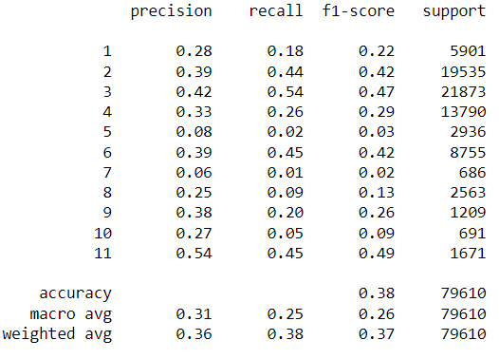

Slide 12
